Slide 1
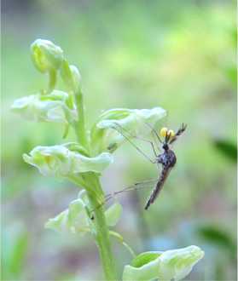
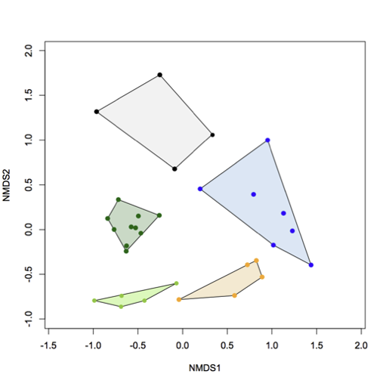
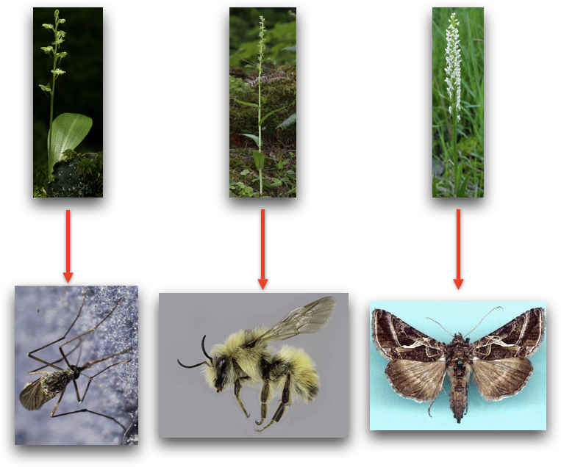
Are differences in pollinators reflected in the floral scent for Platanthera orchids?
Means
PCA
Chloé Lahond

